Slide 1

Linear Regression
Jasamrit Rahala
JRahala

Slide 2
Agenda
When is it used
Where it is used
What is linear regression
Why it works
How to implement it

Slide 3
Real world Applications
Linear regression is a commonly used technique when trying to predict continuous data. It is quick and simple to carry out.
Applications of linear regression include:
Predicting house prices
Forecasting car prices over time and usage
Evaluating students’ marks
Application isn’t limited to large scale companies. We can run linear regression on our own computers with simple python

Slide 4
Use Case
Linear regression is used to predict continuous data, given training data
Data can be split up into discrete and continuous.
Discrete – data can be split up into a set number of values
Continuous – quantitative data that has an infinite number of values
Discrete – marks scored on a test, female / male
Continuous - %, height / weight

Slide 5
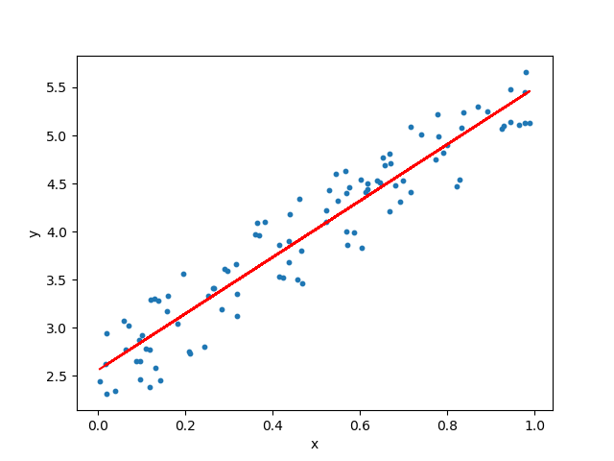
Concept
Linear Regression attempts to fit a line to several data points.
Let’s take the example of pupils revision time vs % marks achieved
Assuming a linear relation between the data
y = f(x)
f(x) = mx + c

Slide 6
Notebook break
Read through the material and get a grasp on the data that we are dealing with as well as the end goal.

Slide 7
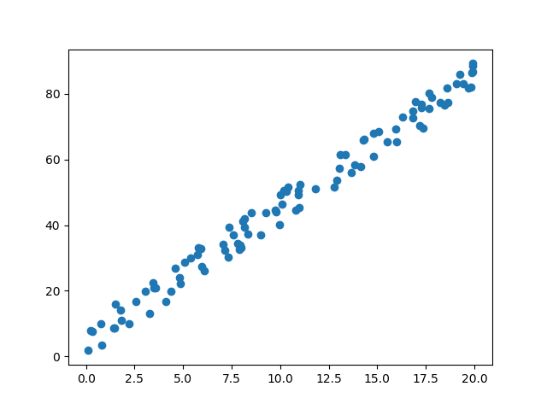
1,000 Lines
Even though we are only adjusting 2 parameters in our function f(x), there are an infinite number possibilities ranging from line 1 to line 1,000. All with differing success.
m = 3
c = 1
m = - 2
c = 80

Slide 8
Which line is better fit?
This one !

Slide 9
Which line is better fit?
This one !

Slide 10
Which line is better fit?
We can’t really tell!

Slide 11
Finding the Best Line
Most of the time it is easy to tell where the best fit line is with our eyes
But computers don’t have eyes (at least not yet)
We need a metric to compare the lines with the data in order to select the best line.
We will define a function which takes in our functions parameters (m,c) and returns how well the line fits the data. This function is called the cost function.

Slide 12
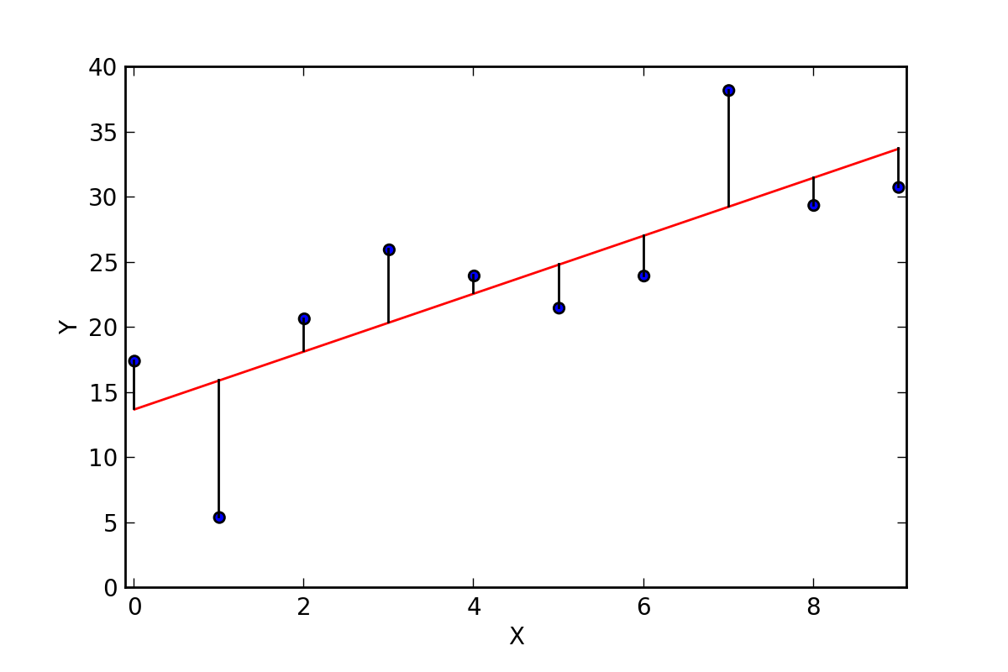
The Cost Function
We evaluate our function by how well it fits the data, in other words how far are the distances between the real data and our predicted line.

Slide 13
The Cost Function
f(x) = 3x + 5
We can loop through our data points in our dataset
For each data point:
Take the x value of the data point (this is the input to our function)
Put the x value into our function (this is the predicted value)
The error is the (predicted value – actual value)
We could sum the total error over all points, however there is a problem…

Slide 14
The Cost Function
n
f(x) = 3x + 5
J(m,c) =
Σ
f(x) - y
i
x, y
f(x)
f(x) - y
[2,12]
f(2) = 3 * 2 + 5 = 11
11 – 12 = -1
[3,9]
f(3) = 3 * 3 + 5 = 14
14 – 9 = 5
Can you spot the problem?

Slide 15
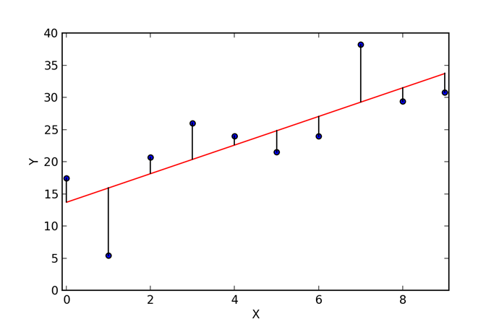
The Cost Function
When the predicted value is higher than the actual value, the error is positive.
When the predicted value is lower than the actual value, the error is negative.
If we sum these values, the negative error cancels out the positive error. This does not give a true reflection of the line’s fit.

Slide 16
The Cost Function
In order to remove the cancelling effect of positive + negative we square the difference between the real and predicted data
n
2
J(m,c) =
Σ
(f(x) – y)
i
f(x) = m * x + c

Slide 17
Notebook break
Work through the notebook and start to construct the linear regression class. Observe the effects different parameters have on the cost function, through the visuals. Get a grasp on what we are trying to find and minimise.

Slide 18
Adjusting parameters
We can brute force a solution by taking a large range of values for m and c. Then apply the cost function to every combination, retaining the lowest cost parameters.
min_cost = 999999
for m in range(-100, 100):
for c in range(-100, 100):
min_cost = min(min_cost, cost(m,c))

Slide 19
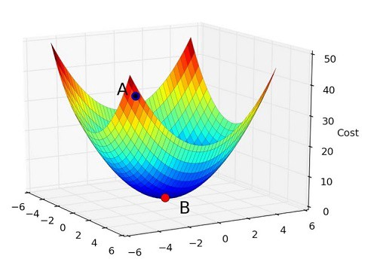
Cost Curve
Observing the cost function graph over a 2D space we can see a convex curve.
c
m

Slide 20
Cost Curve
The arrow represents the direction we want to move in. We are know that we are moving downwards, but we do not know if we want to move left / right or further / closer.
c
m

Slide 21
Cost Curve
Lets break down the problem. We know we are moving downwards (lowering the cost). Let’s focus on changing the m variable to lower the cost.
Cost
m
c
m

Slide 22
Cost Curve
In order to figure out what direction to move m in we can use calculus. In simple words this means figuring out how much a small change in m changes the cost.
ΔCost
Cost
ΔCost
Δm
Δm
m

Slide 23
Cost Curve
This holds true for changing the value of c as well. We can now go through the equations to figure out this gradient. And move in the opposite direction of it.
ΔCost
Cost
ΔCost
Δc
Δc
c

Slide 24


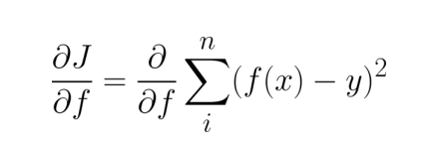

Partial Derivatives I
The equation that defines our line is shown below.
And we are trying to minimise the cost, shown below.

Slide 25


Partial Derivatives II
Change in cost (J) with respect to m
Change in cost (J) with respect to c

Slide 26
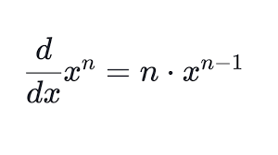
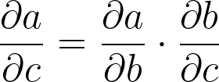
Partial Derivatives III
To figure out these equations we will need to use two rules.
The power rule
The chain rule

Slide 27
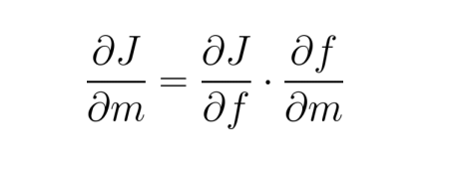
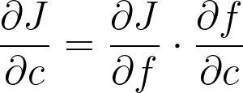
Partial Derivatives IV
Applying the chain rule our equations can be broken into two steps
Let us therefore figure out how the cost changes with respect to f

Slide 28
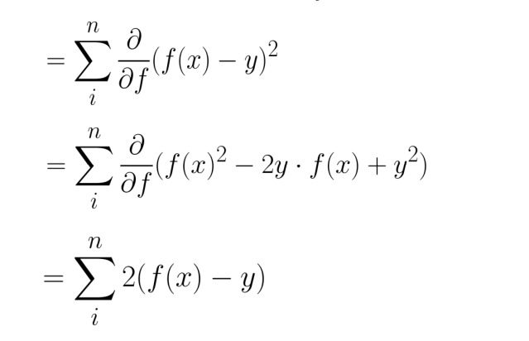
Partial Derivatives V
We can expand the J term and expand the squared term
We can then drop all terms that do not effect f and use the power rule.

Slide 29
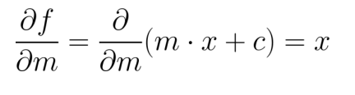
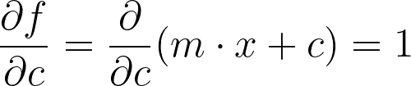
Partial Derivatives VI
Now we can figure out how f changes with respect to m and c
After expanding we can observe that by increasing m we change f by a scale of x
After expanding we can observe that by increasing c we change f by a scale of 1

Slide 30
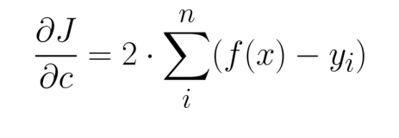
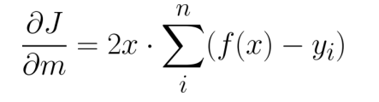
Partial Derivatives VII
By plugging these values into the original chain rule equation we get the following gradients.

Slide 31
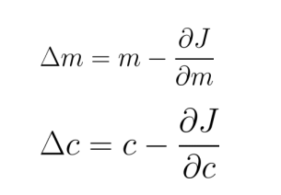
Update rules

Slide 32
Notebook break
Develop your understanding of the convex cost curve and why this approach works. Continue constructing the linear regression class.

Slide 33
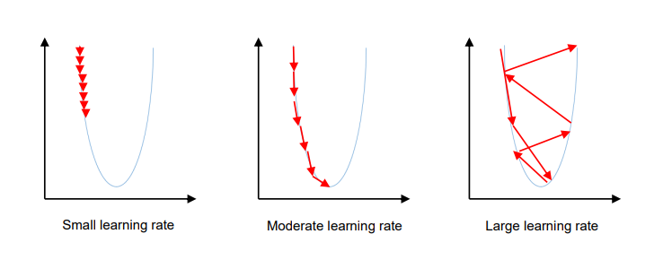
Learning Rates

Slide 34

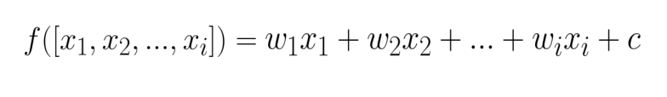
Multivariable Regression

Slide 35
Notebook break
Experiment with different learning rates and observe how finding a suitable learning rate isn’t a straightforward task and how we can apply the concepts from linear regression to multiple variables.

Slide 36
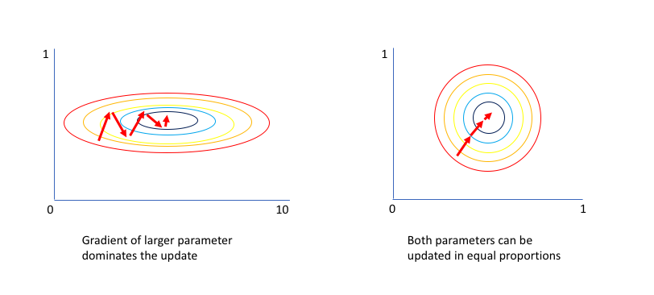
Normalisation

Slide 37
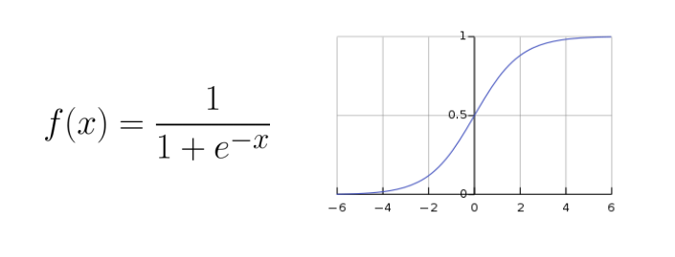
Limitations
Whilst we can calculate linear functions with linear regression there are some cases where this wont work.
Take for example, height vs age, there will be a relative linear relation up till age 18 when growth levels off. We can model these relations with more complex functions; in place for f(x).

Slide 38
Recap
What linear regression is and where / when it is used
Having metrics to analyse a model (cost function)
The intuition and maths behind minimising a cost function
Using the correct data
The limitations of the model as well as the adaptability of the model

Slide 39
Thank you
Jasamrit Rahala
JRahala

